Slide 1
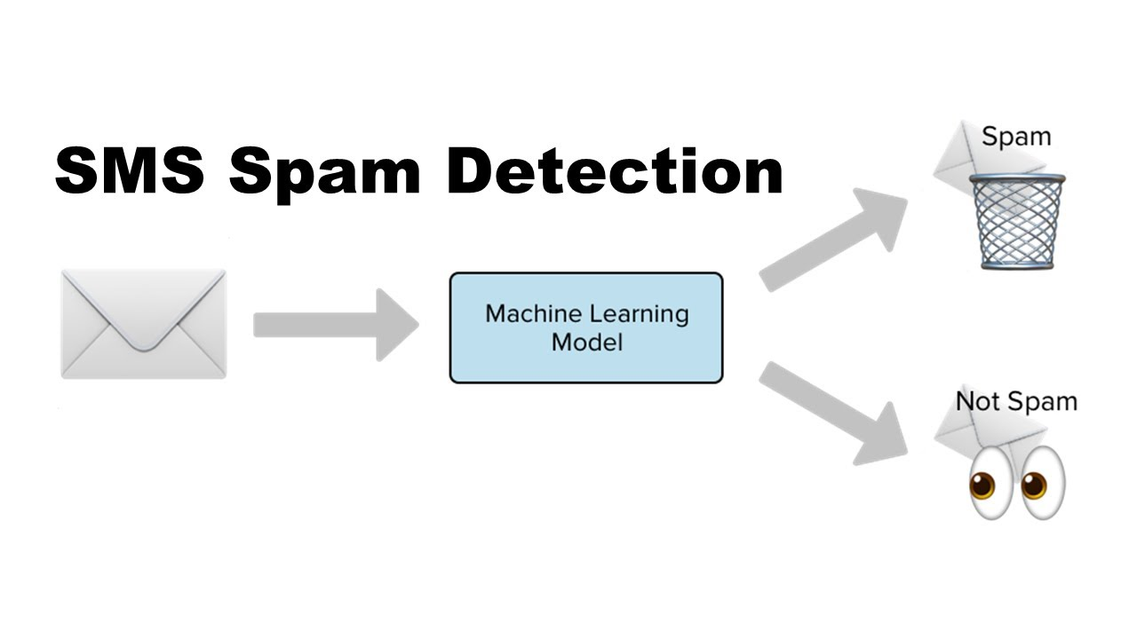
`.
SMS SPAM DETECTION
By :-NISHANT GHAWALKAR

Slide 2
INTRODUCTION
Spam is a growing problem in today's world, with more and more people falling victim to fraudulent messages.
SMS is one of the most effective forms of communication.it is based on cellular communication systems,just the cell phones needs to be in the network coverage area in order to send or receive the message.
In this presentation, I will discuss some of the common types of SMS spam, the risks associated with them, and the best practices to avoid falling victim to SMS spam.

Slide 3
OBJECTIVE
Objective of SMS spam detection is to identify and filter out the unwanted messages that are sent to users' phones. With the rise of mobile technology, more and more people are using their phones as their primary means of communication.

Slide 4


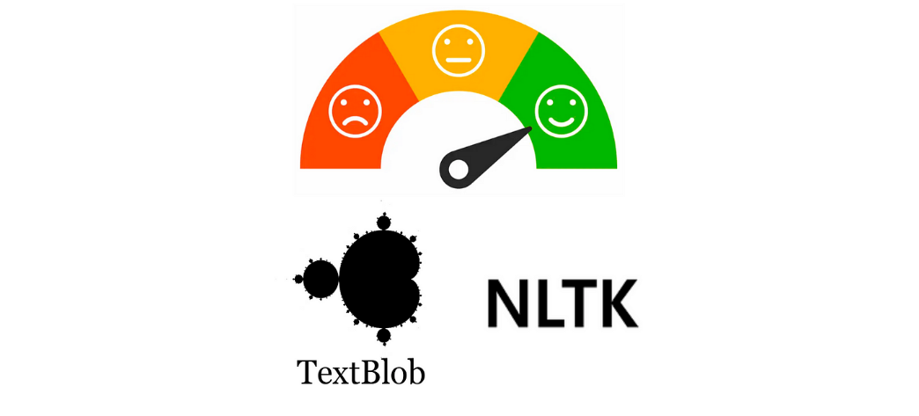
TOOLS AND PLATFORMS
Tool : Python
Platform : Jupyter Notebook
Library used : NLTK and TextBlob,sk learn

Slide 5
FLOW CHART
Data Collection
NLP Data Pre-processing
Vectorization
Model building using ML

Slide 6
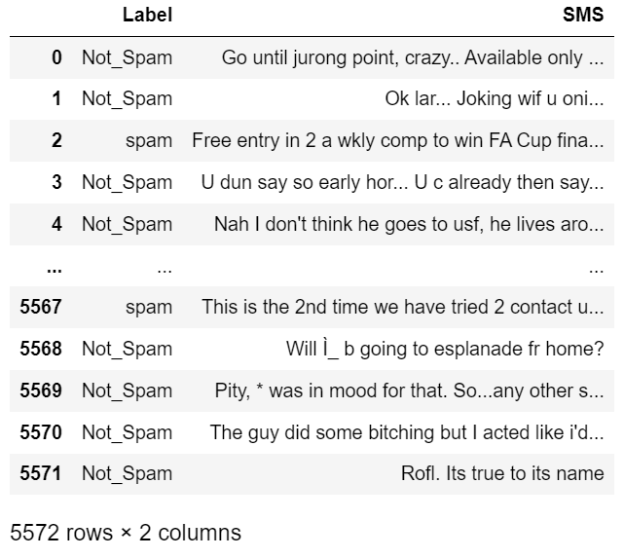
DATA DESCRIPTION
.

Slide 7
data preprocessing using nlp
Natural Language Processing (NLP) is a subfield of artificial intelligence (AI).
Data preprocessing is a crucial step in natural language processing (NLP) that involves cleaning and transforming raw text data into a format that can be easily analyzed by machine learning algorithms.
NLP enables computers to understand natural language as humans do.
In this introduction, we will explore the importance of data preprocessing in NLP and some common techniques used for it.
One of the primary objectives of data preprocessing is to remove any noise or irrelevant information from the text data.
This includes removing punctuation, stop words, and special characters, as well as correcting spelling errors and normalizing text by converting it to lowercase.

Slide 8
DATA PREPROCESSING
Converted to Lower
Cleaning data(removing numbers, removing punctuations, removing stopwords, removing url, removing whitespaces)
Common Words
Removing Emojis From Data
Lemmatization
Model Building

Slide 9
vectorization sparse matrix
Vectorization of sparse matrices refers to the process of converting a sparse matrix into a vector format that can be used for mathematical operations and machine learning algorithms.
Sparse matrices are matrices with a large number of elements that are zero, and only a small number of elements that are non-zero.
Vectorization involves identifying the non-zero elements of the sparse matrix and storing them in a compressed format that takes up less memory.
This compressed format can then be used for mathematical operations and machine learning algorithms that require matrix operations.

Slide 10
data partition
Dataset partitioned into two Subset
By using Train Data we Build The Model And In Test Data We Check The Performance of The Performance of The Model
DATASET
Train data
70%
Test data
30%

Slide 11
model building:-
In Model Building We perform Different Types of model.
We Can Check Accuracy On Different Models Which Gives Different Accuracy.
SR.No | Model Type | Train Accuracy | Test Accuracy
1 | SVM | 100 % | 97 %
2 | MNB | 98 % | 97 %
3 | GNB | 81 % | 75 %
4 | LR | 99 % | 97 %
5 | RF | 100 % | 96 %

Slide 12
selecting best model
Logistic Regression tree can be more accurate than SVM,RF,GNB,MNB.
Because we train them to correct each other's errors, they're capable of capturing complex patterns in the data.
High Accuracy
Robust to Outliers
I explore multiple algorithms and evaluate their performance on my dataset to determine which one works best on the dataset.

Slide 13
Advantages:-
Time-saving: SMS spam or not spam detection can save valuable time for both individuals and businesses by automatically filtering unwanted messages from the inbox.
Enhanced security: SMS spam can be used to carry out phishing attacks or distribute malware, so detecting and blocking these messages can help improve overall security.
Improved user experience: Receiving fewer unwanted messages can improve the overall user experience and make it easier to find and respond to important messages.
Cost savings: For businesses, detecting and blocking SMS spam can save money by reducing the cost of sending messages to invalid or uninterested recipients.
Overall, SMS spam or not spam detection can provide many benefits for both individuals and businesses, including improved efficiency, security, and user experience.

Slide 14
CONCLUSION
Detection of spam OR not spam is important for securing message and SMS communication.
The accurate detection of spam is a big issue, and many detection methods have been proposed by various researchers.
However, these methods have a lack of capability to detect the spam accurately and efficiently.

Slide 15
Thank You

